Slide 1

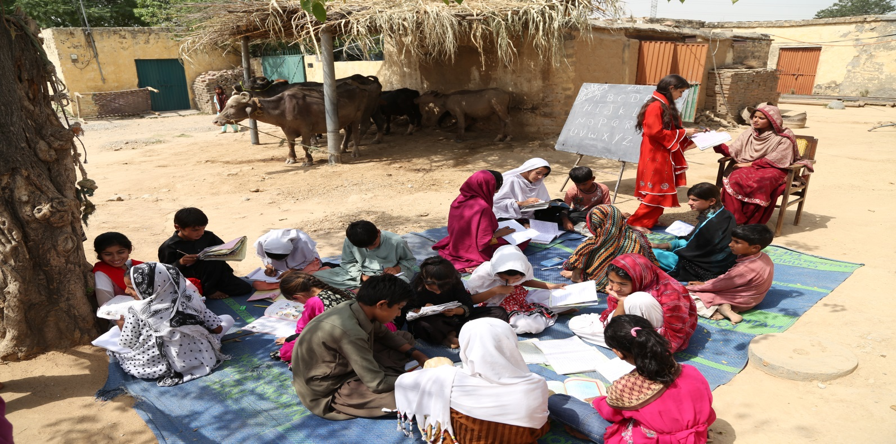
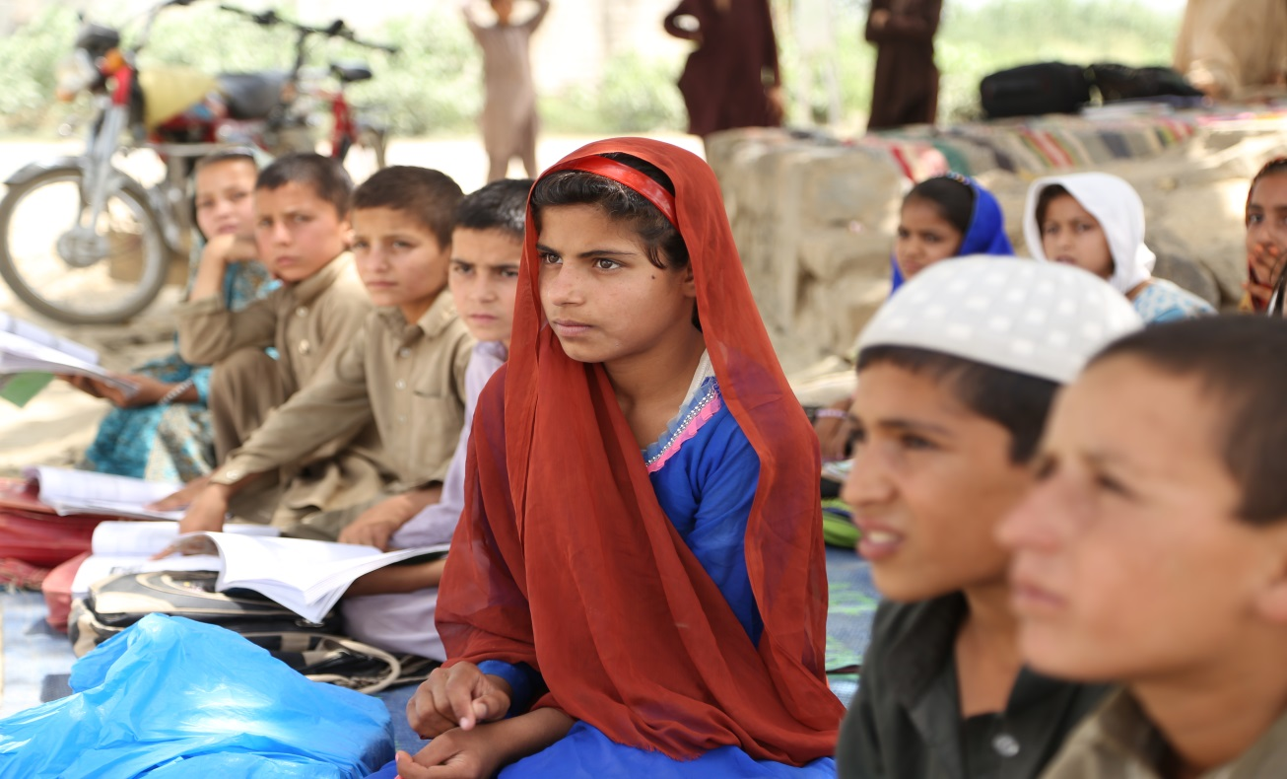
Ministry of Federal Education & Professional Training
FEDRAL POLICY POSITION POST SCENARIO ARTICLE 25-A
Presented by: Muhammad Irfan Khan Jadoon , Deputy Secretary ,
Ministry of Federal Education and Professional Training

Slide 2
Right to Education Laws
“Constitution of Pakistan 1973, Article 25-A: "The state shall provide free and compulsory education to all children of five to sixteen years of age in such manner as may be determined by law."
“Right to free and compulsory Education Act, 2012”,
Section- 3: Right of child to free education: Every child, regardless of sex, nationality or race, shall have a fundamental right to free and compulsory education in neighborhood school.
Section- 4: Special Provision for education.- Where a child has not been admitted in any school or though admitted, could not complete his education, then he shall be admitted in an appropriate class in a formal or Non-Formal School.

Slide 3

Declaration as Human Right
According to Article 26 of “Universal Declaration of Human Rights”
(1) Everyone has the right to education. Education shall be free, at least in the elementary and fundamental stages. Elementary education shall be compulsory. Technical and professional education shall be made generally available and higher education shall be equally accessible to all on the basis of merit.

Slide 4
1- ECCE: Expanding early childhood care and education
2- UPE: Universal primary education; Free and compulsory primary education for all
3- Continuing Education: Learning and life skills programs for young and adults
4- Literacy: 50% increase in literacy rates
5- Gender: Eliminating gender disparities in primary and secondary by 2005, and gender equality in education by 2015
6- Quality: Improving quality of education

Slide 5

Millennium Development Goals (MDGs)
Goal 2- Achieve universal primary education
Target 3 – Ensure that, by 2015, children everywhere, boys and girls alike, will be able to complete a full course of primary schooling
Goal 3- Promote gender equality and empower women
Target 4 – Eliminate gender disparity in primary and secondary education, preferably by 2005, and to all levels of education no later than 2015.

Slide 6
IMPLEMENTATION OF ARTICLE 25-A
BECS Program of Federal Government aims at educating the millions of Out-Of-School-Children (OOSC) who are deprived of this fundamental right. BECS programs is the best options, due to its mandate, design, Non-Formal Education, and its offices and schools country-wide, to make accelerated efforts to achieve the UPE/ MDG targets by educating Out-of-School-Children and increasing literacy rate.
Province / Area | BECS Schools
Islamabad Capital Territory (ICT) | 248
Federally Administrated Tribal Area | 971
Gilgit Baltistan | 1425
Azad Jammu & Kashmir | 203
Khyber Pakhtunkhwa | 1389
Balochistan | 607
Punjab | 5687
Sindh | 1674
Total | 12,204

Slide 7
NCHD Schools
NCHD Program is another Federal Government program which aims at educating the millions of Out-Of-School-Children (OOSC) who are deprived of this fundamental right. The detail of NCHD Feeder Schools is as under
Sr. | Province | FS System | Enrollment
1 | Total | 6,581 | 216,150
2 | Punjab | 1,924 | 58,140
3 | Sindh | 3,679 | 109,590
4 | KPK | 349 | 22,500
5 | Balochistan | 440 | 20,340
6 | AJK | 89 | 2,580
7 | FATA | 50 | 1,500
8 | GB | 50 | 1,500

Slide 8
Education Policy 2009 – Policy Actions- ECE
Comprehensive Early Childhood Care & Education
Improvements in ECE quality, 2 year training for ECE teachers
One year pre-primary edu/universal access in 10 years (3-5 year)
ECE attached to primary schools

Slide 9
Promised Policy Provisions in Pakistan – 1998-2010
Recognition and strengthening of Katchi class as part of formal system and opening of Katchi/ECE classes in the public sector primary schools as the main strategy for increased access.
Full-time teachers for katchi class/pre-primary education will be trained and recruited.
Curricula development for ECE and coordinate for development of teaching-learning materials. Instructional material, teaching kit and A.V. Aids for ECE will be developed and provided to ECE centers and schools.
Free provision of Activity-based textbook (Qaaida) and other learning material for pre-primary education

Slide 10
After Article 25-A Scenario
Gross Enrolment Ratio (GER) for ECE is 99% in 2007-08 (despite 7.3 million out of school children)
At least one year pre-primary education shall be provided by the State and universal access to ECE shall be ensured within the next ten years.
Provision of financial and food support to children who drop out because of poverty at ECE
Two year pre-service training to ECE teachers based on NCECE

Slide 11
Pre-Primary Enrolments by Gender and Area (2011-12)
 | Boys | Girls | Total
Urban | 1,490,075 | 1,305,458 | 2,795,533
Rural | 3,225,527 | 2,491,938 | 5,717,465
Total | 4,715,602 | 3,797,396 | 8,512,998
Source: AEPAM 2011-12

Slide 12
Provincial Trends
ASER 2012 – National (Rural)

Slide 13
Sources of Financing for ECE –ECD
Government of Pakistan - 92-95% - through public sector financing
ODA 5-8%
Donors in ECE : AusAid; USAID, UNICEF; UNESCO , CIDA; DFID INGOs – Save the Children; Plan, Oxfam GB ; AKF; OSF (research/baseline) Dubai Cares etc. - ..
Private Sector : 29 % rural 50-60 % urban presence, both, for and not for profit
PPPs Policy : Since 2002 policy guidelines on PPPs – encouraged with incentives- access to public sector facilities – not necessary transfer of resources for sharing risks with outcomes
2009 -2010 PPP Laws emerge in two provinces (ADB Led) but ‘infrastructure oriented’- services only related to infrastructure.
                Under ESPs provinces are looking to expand the scope of PPP Laws to include services exploring – procurement of services for education including ECE – Services include: ‘mobilization for enrolment; school improvement curriculum, training, quality assurance, research , design etc.

Slide 14
Issue/ challenges and way forward for ECE in Pakistan
There is a dire need for adapting the curriculum and classroom sources for meeting the diverse needs of 3-5 year children
Immense need for developing deeper understanding of “how learning takes place”
Subsequent financial allocation in Provincial budget is required especialy for ECE
Subtracting practices that are embedded in behaviorist learning approach
Promoting a culture of reflective practice to avoid mechanistic implementation of ECE curriculum
Social and public accountability

Slide 15
Cont.
Health, Social Welfare, Women’s Welfare and Education ministries to align their targets and mechanisms
After 18th amendment it’s the provincial subject, but a number of issues and challenges are faced at provincial level like:
Lack of awareness regarding the importance of ECE
Inadequate ECE programs
Insufficient financial resources for ECE programs
Lack of networking and coordination among agencies and institutions implementing and developing ECE programs
Experience and programs of the NGO/private sector are restricted in scope and scale

Slide 16
Cont.
Lack of capacity in the public sector
Poor quality and non-availability of appropriate and adequate learning material
lack of integrated programming for ECD
Non availably of database
Inadequate teachers training Program for ECE

